Slide 1
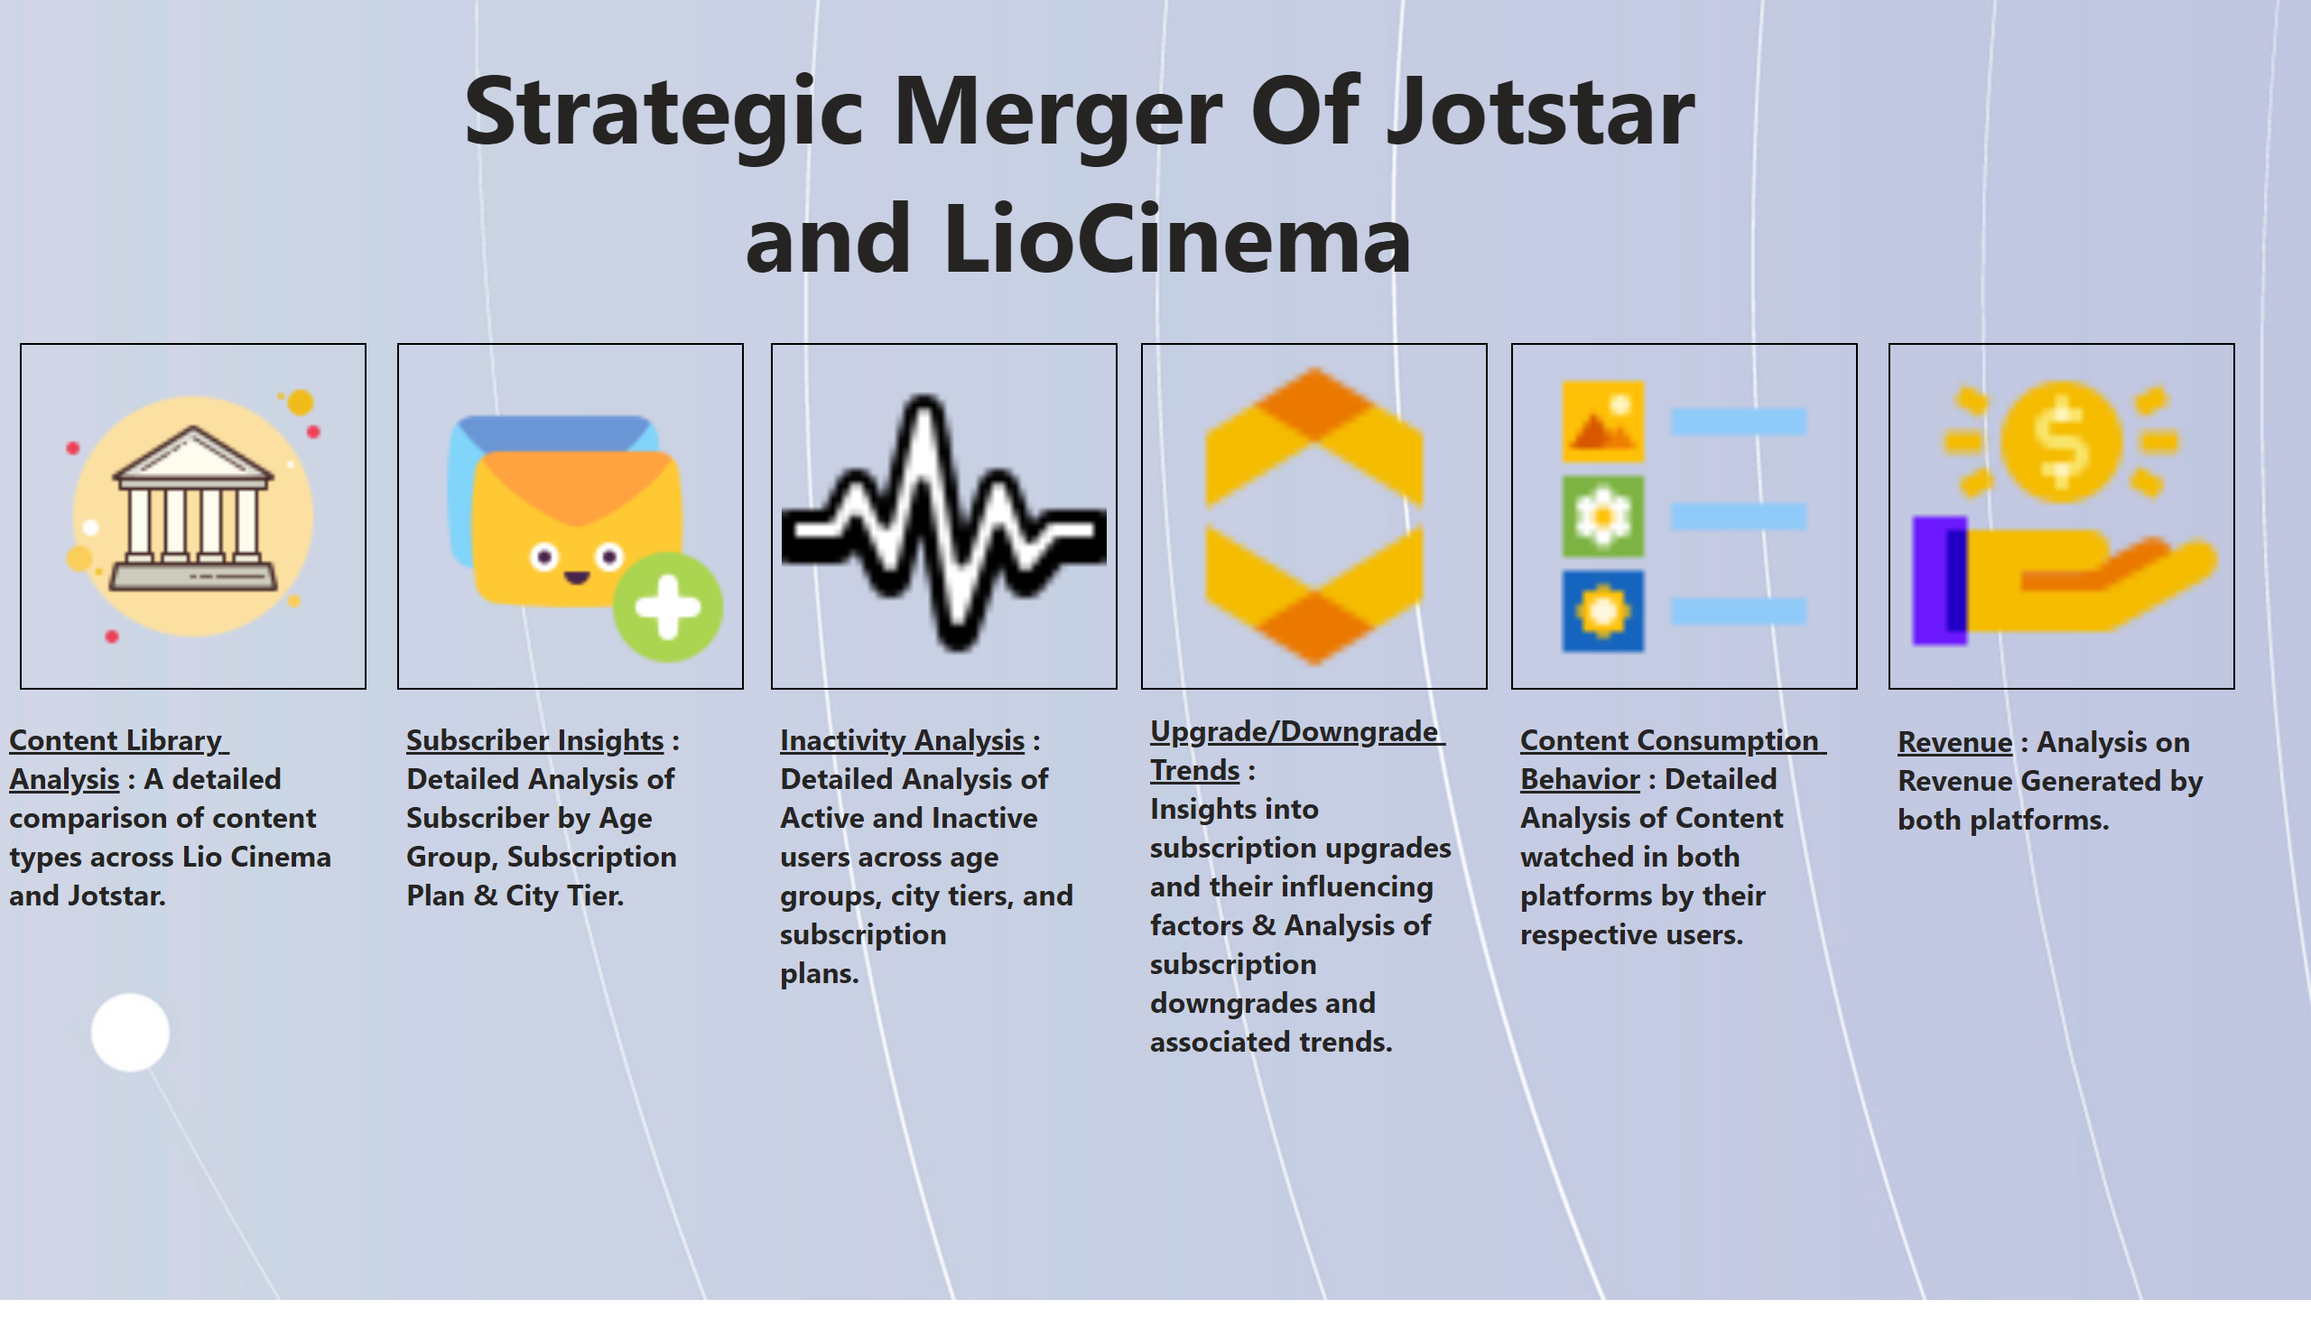
HomePage
Notes:
image
No alt text provided
image
No alt text provided
image
No alt text provided
image
No alt text provided
image
No alt text provided
image
No alt text provided
textbox
No alt text provided
textbox
No alt text provided
textbox
No alt text provided
textbox
No alt text provided
textbox
No alt text provided
textbox
No alt text provided
textbox
No alt text provided

Slide 2
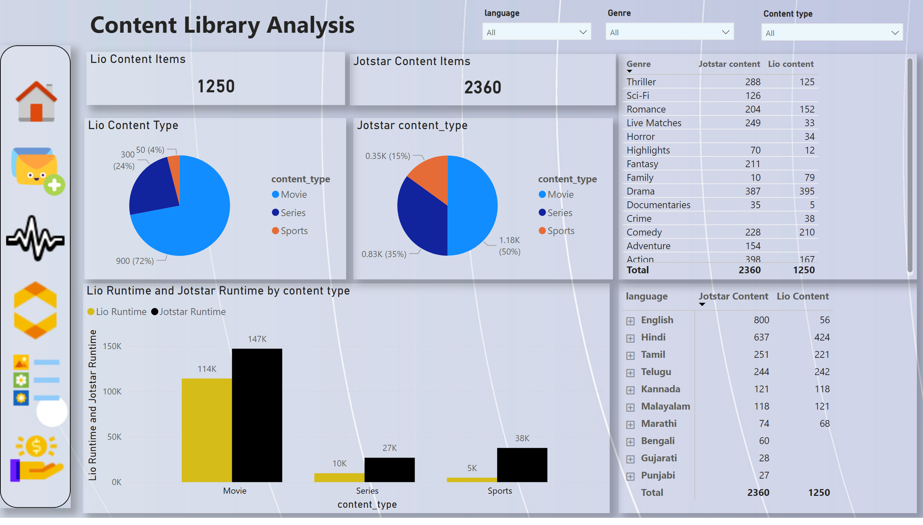
Content Library Analysis
Notes:
Lio Content Items
No alt text provided
Jotstar Content Items
No alt text provided
pivotTable
No alt text provided
Lio Content Type
No alt text provided
Jotstar content_type
No alt text provided
slicer
No alt text provided
tableEx
No alt text provided
slicer
No alt text provided
slicer
No alt text provided
Lio Runtime and Jotstar Runtime by content type
No alt text provided
textbox
No alt text provided
shape
No alt text provided
image
No alt text provided
image
No alt text provided
image
No alt text provided
image
No alt text provided
image
No alt text provided
image
No alt text provided

Slide 3
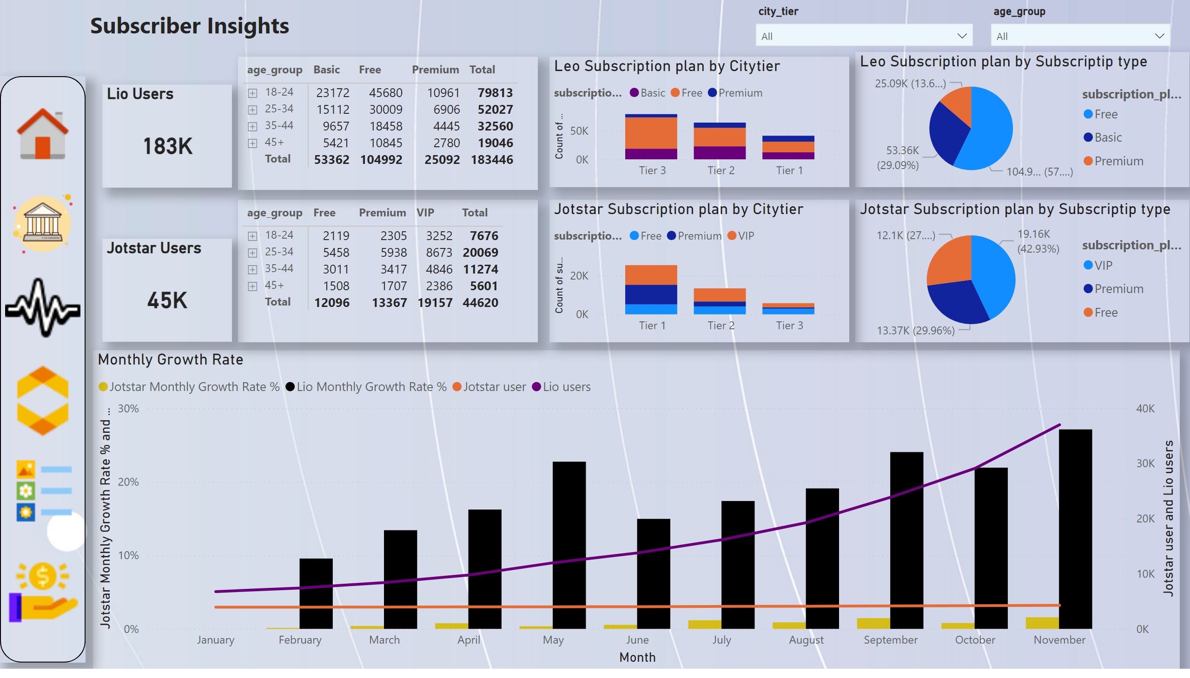
Subscriber Insights
Notes:
Lio Users
No alt text provided
Jotstar Users
No alt text provided
Monthly Growth Rate
No alt text provided
pivotTable
No alt text provided
Jotstar Subscription plan by Subscriptip type
No alt text provided
pivotTable
No alt text provided
Leo Subscription plan by Subscriptip type
No alt text provided
shape
No alt text provided
textbox
No alt text provided
slicer
No alt text provided
slicer
No alt text provided
Jotstar Subscription plan by Citytier
No alt text provided
Leo Subscription plan by Citytier
No alt text provided
image
No alt text provided
image
No alt text provided
image
No alt text provided
image
No alt text provided
image
No alt text provided
image
No alt text provided

Slide 4
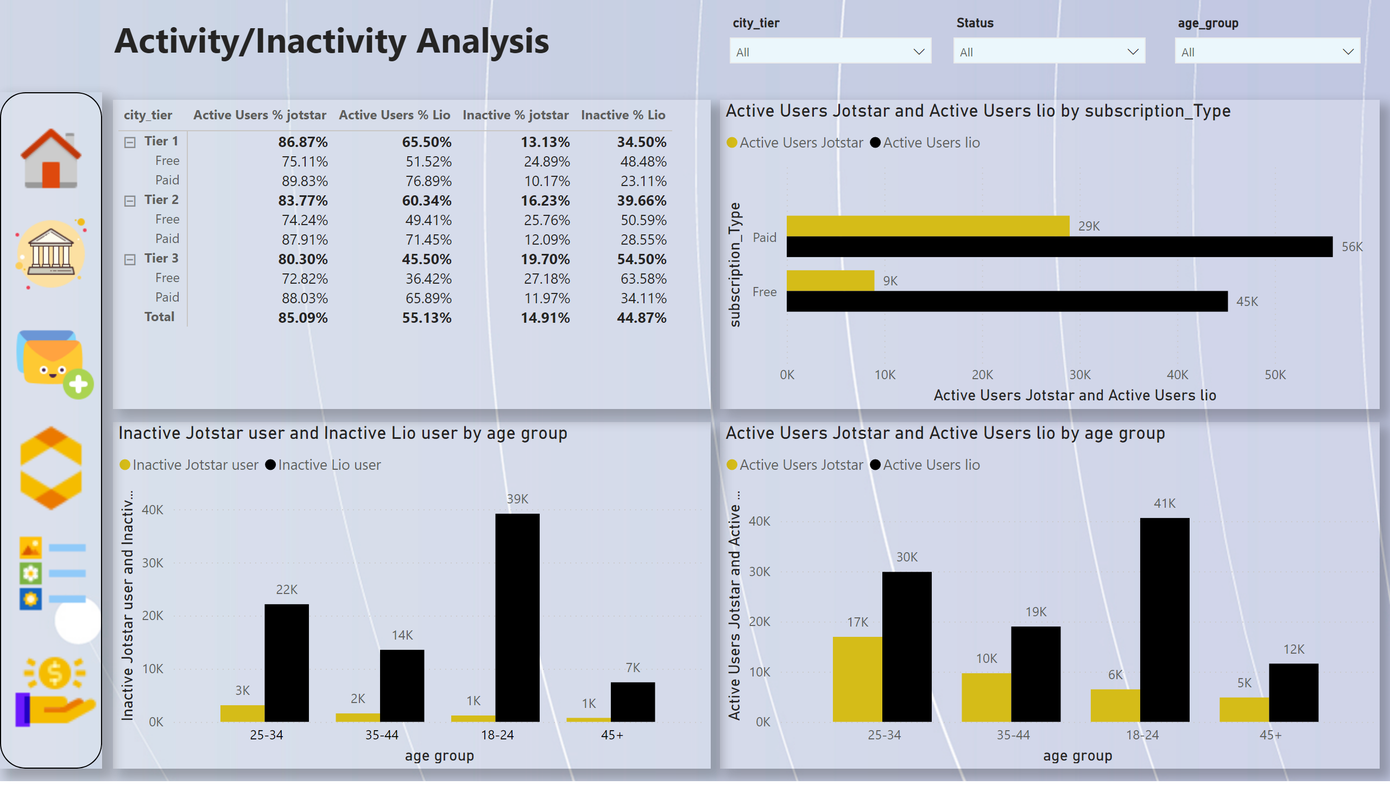
Inactivity Analysis
Notes:
clusteredColumnChart
No alt text provided
clusteredColumnChart
No alt text provided
clusteredBarChart
No alt text provided
shape
No alt text provided
pivotTable
No alt text provided
textbox
No alt text provided
slicer
No alt text provided
slicer
No alt text provided
slicer
No alt text provided
image
No alt text provided
image
No alt text provided
image
No alt text provided
image
No alt text provided
image
No alt text provided
image
No alt text provided

Slide 5
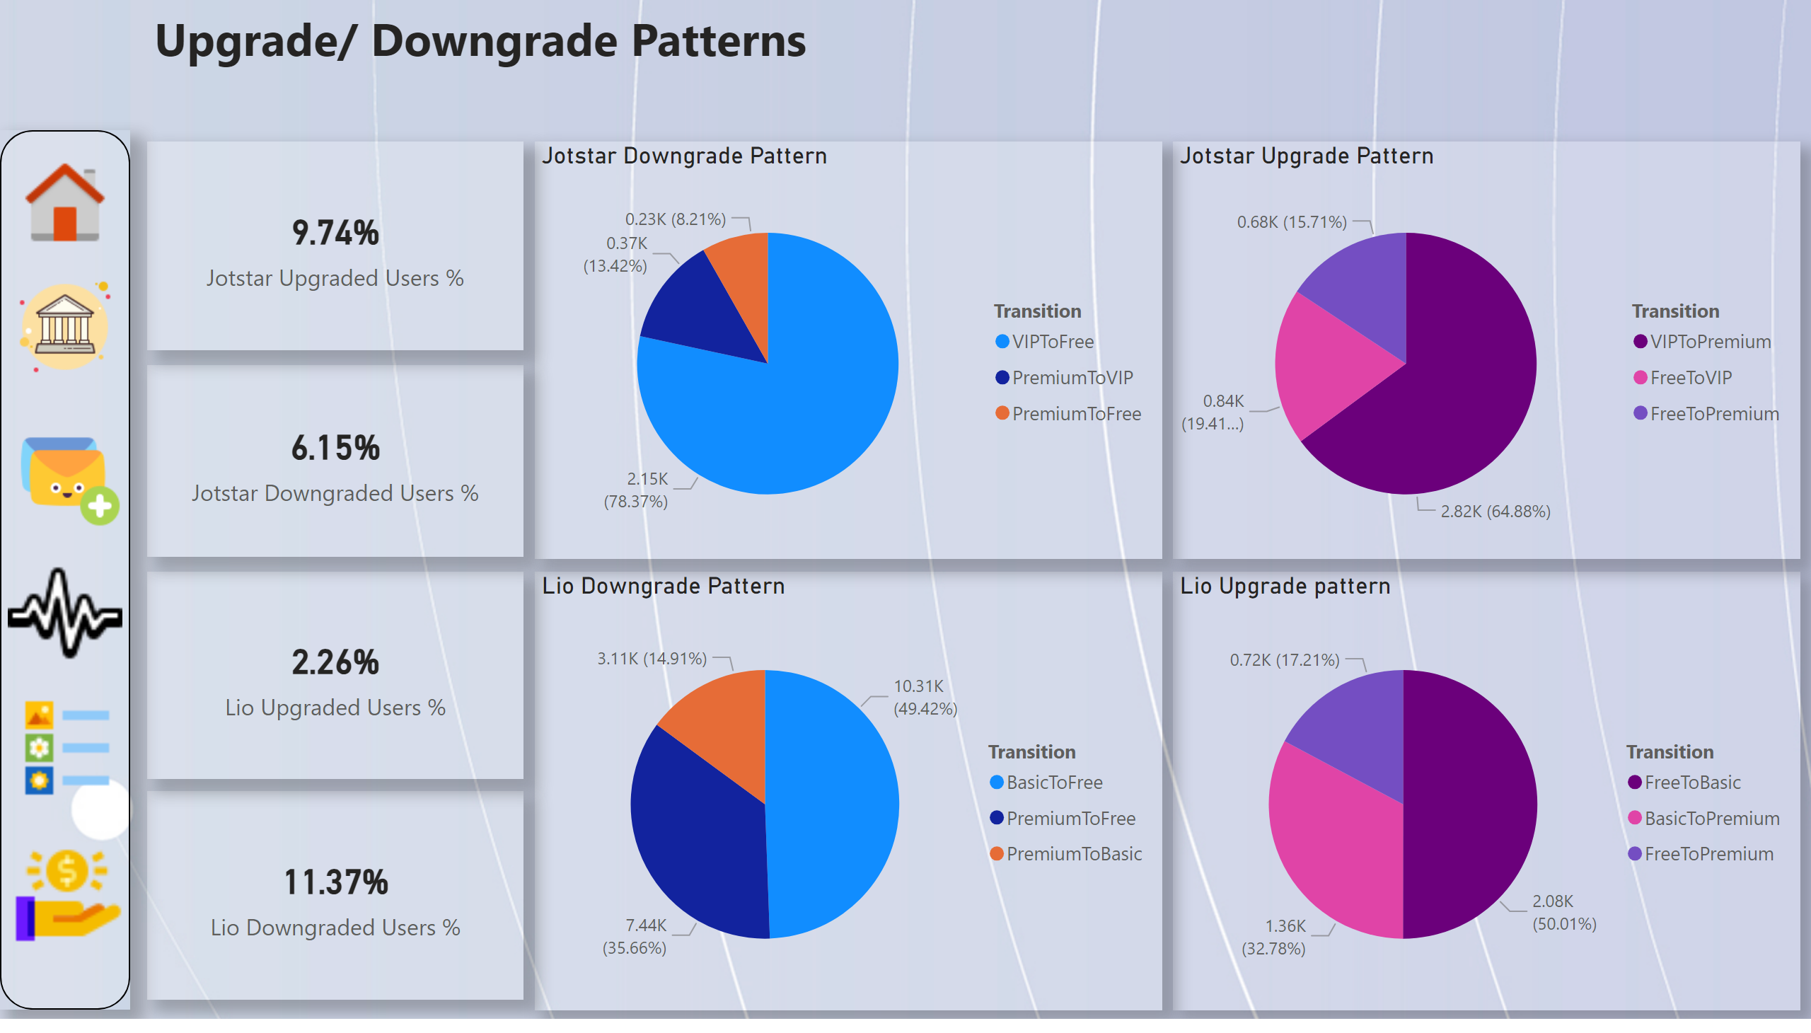
Upgrade/Downgrade Patterns
Notes:
shape
No alt text provided
Lio Upgrade pattern
No alt text provided
Jotstar Upgrade Pattern
No alt text provided
Lio Downgrade Pattern
No alt text provided
Jotstar Downgrade Pattern
No alt text provided
card
No alt text provided
card
No alt text provided
card
No alt text provided
card
No alt text provided
textbox
No alt text provided
image
No alt text provided
image
No alt text provided
image
No alt text provided
image
No alt text provided
image
No alt text provided
image
No alt text provided

Slide 6
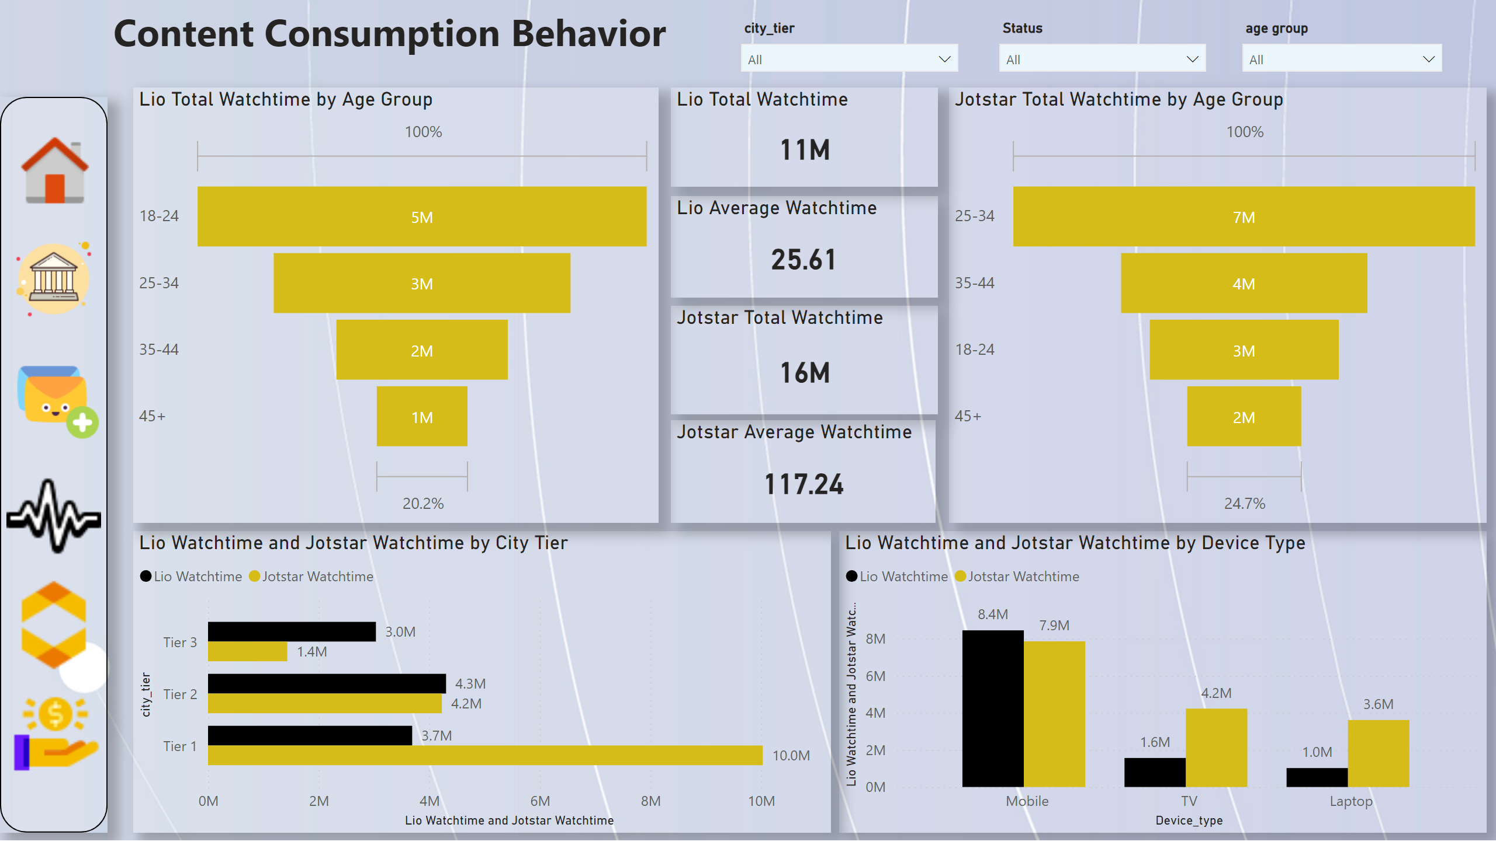
Content Consumption Behavior:
Notes:
shape
No alt text provided
Lio Watchtime and Jotstar Watchtime by Device Type
No alt text provided
Lio Watchtime and Jotstar Watchtime by City Tier
No alt text provided
Lio Total Watchtime by Age Group
No alt text provided
Jotstar Total Watchtime by Age Group
No alt text provided
Lio Total Watchtime
No alt text provided
Lio Average Watchtime
No alt text provided
Jotstar Total Watchtime
No alt text provided
Jotstar Average Watchtime
No alt text provided
textbox
No alt text provided
slicer
No alt text provided
slicer
No alt text provided
slicer
No alt text provided
image
No alt text provided
image
No alt text provided
image
No alt text provided
image
No alt text provided
image
No alt text provided
image
No alt text provided

Slide 7
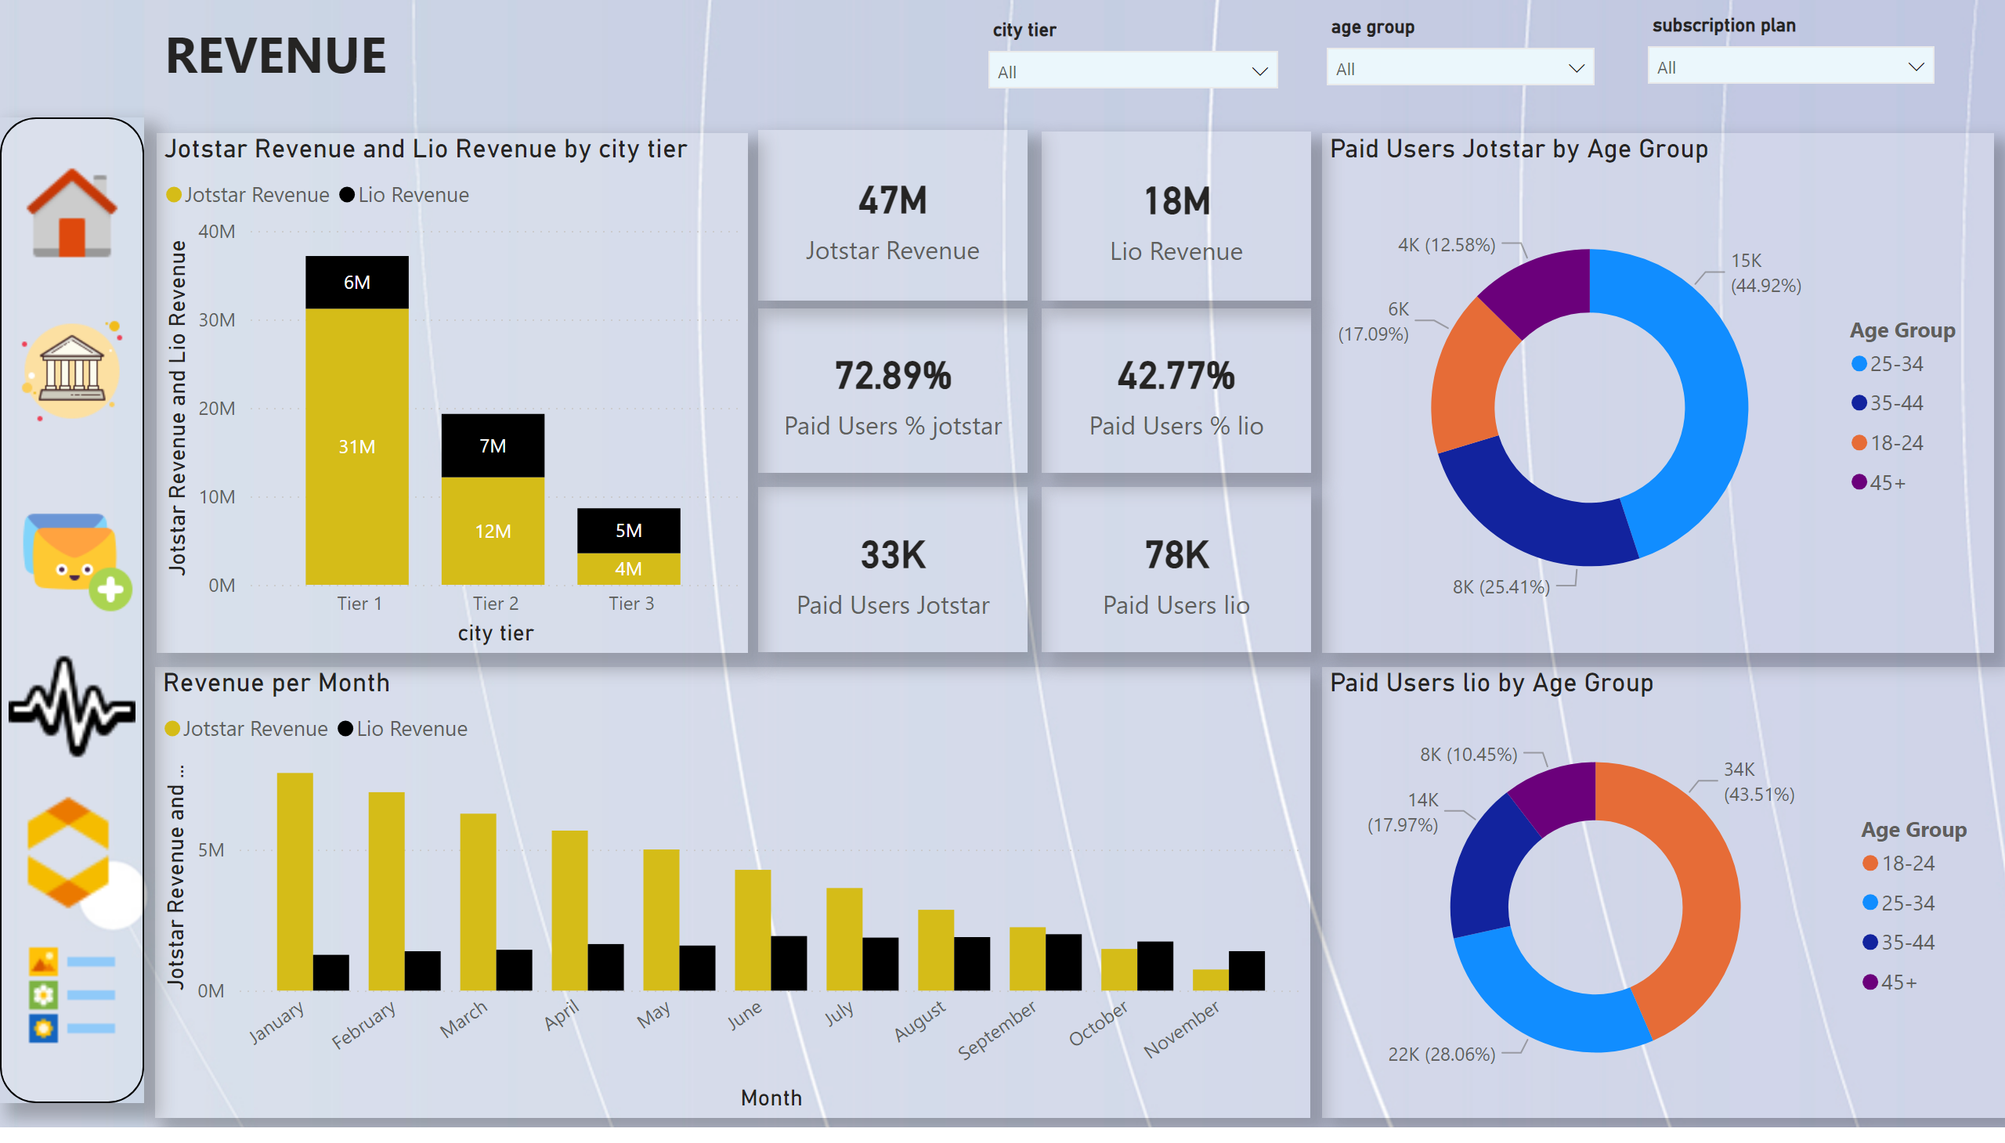
Revenue
Notes:
shape
No alt text provided
Revenue per Month
No alt text provided
columnChart
No alt text provided
card
No alt text provided
card
No alt text provided
card
No alt text provided
card
No alt text provided
card
No alt text provided
card
No alt text provided
donutChart
No alt text provided
donutChart
No alt text provided
textbox
No alt text provided
slicer
No alt text provided
slicer
No alt text provided
slicer
No alt text provided
image
No alt text provided
image
No alt text provided
image
No alt text provided
image
No alt text provided
image
No alt text provided
image
No alt text provided

